Slide 1

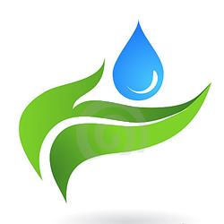
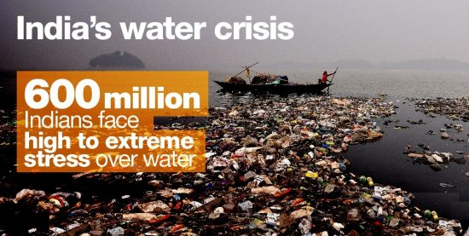
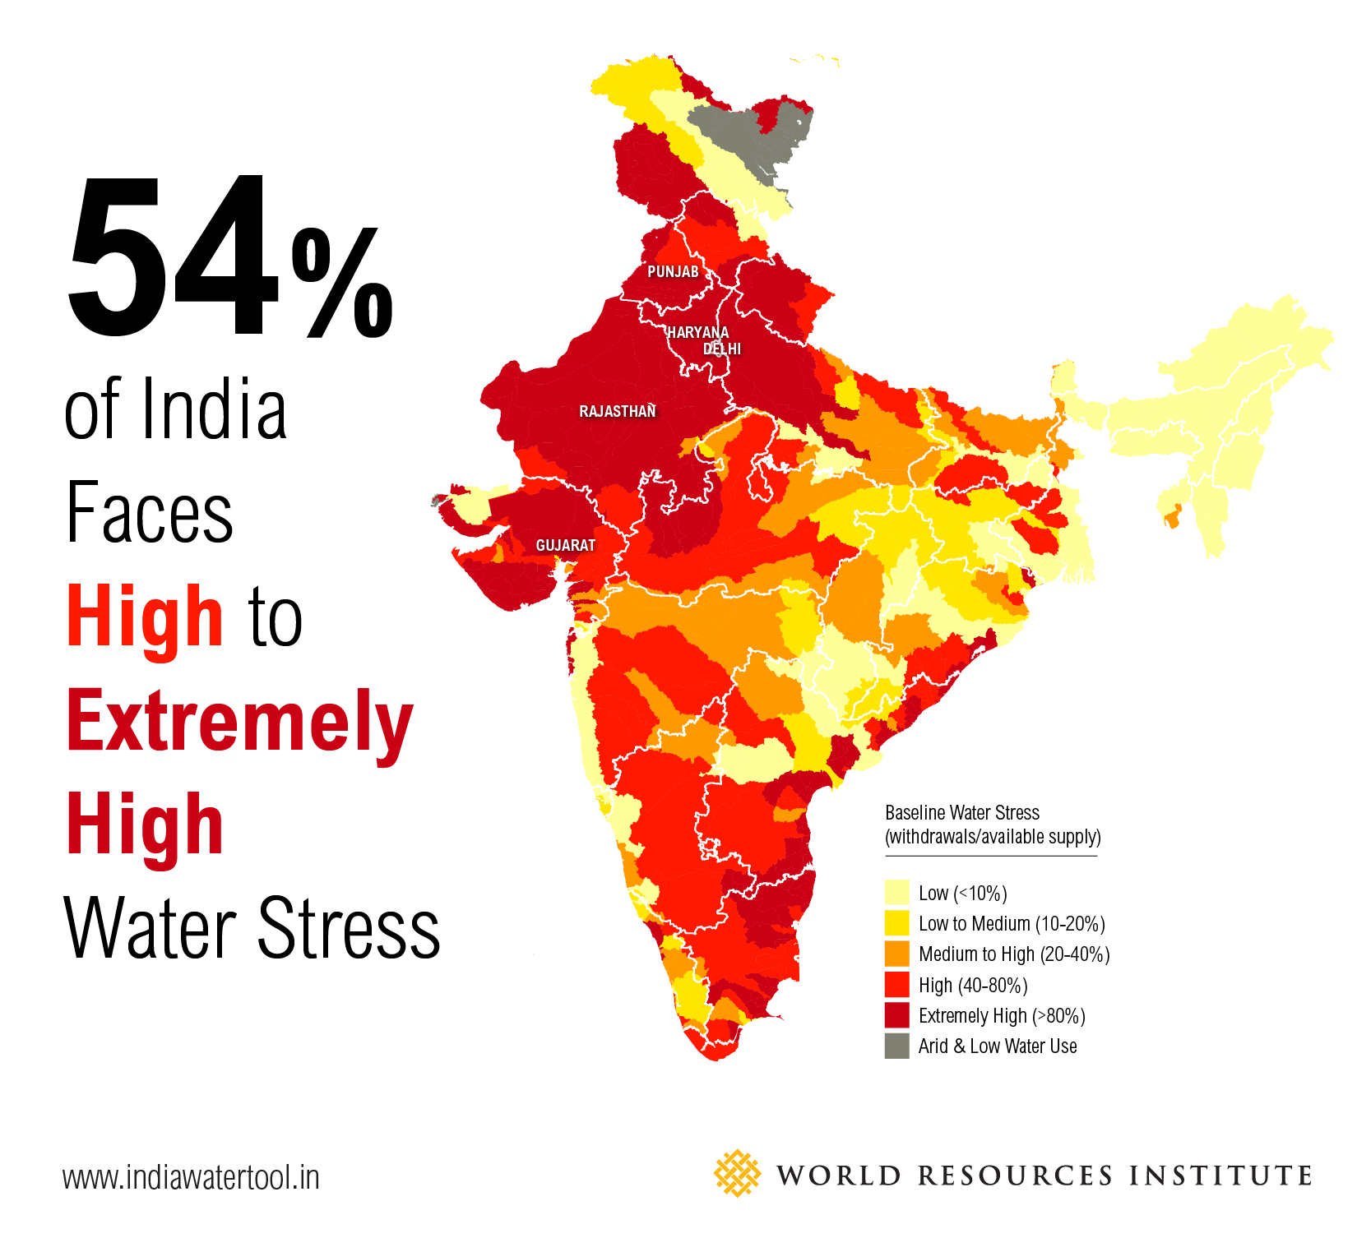
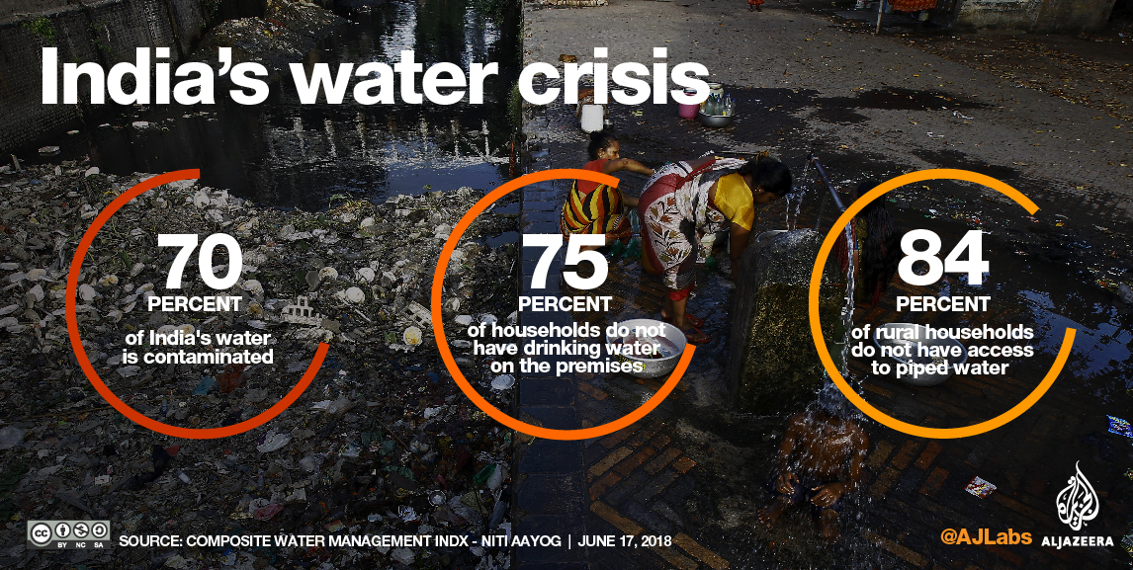
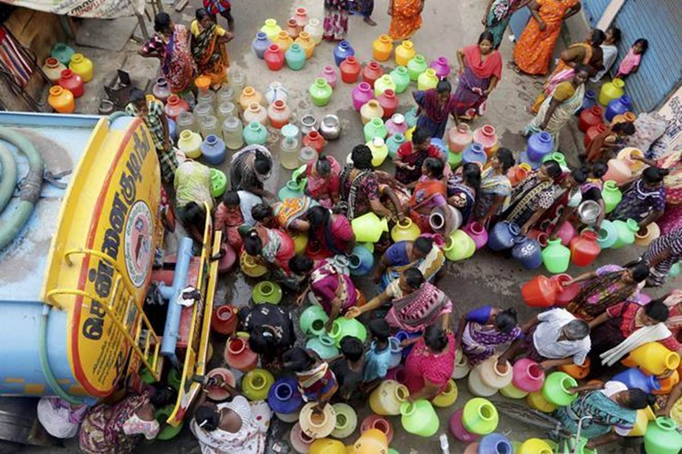
Water Crisis in India is it Too late?
Vipul kesari, Manish Kushwaha, Unknown,unknown
2018118,2018-----,2018----,2018----
ABSTRACT
Background and Relevance
RESULTS
Methodology and Justification
Click here to insert your Abstract text. Type it in or copy and paste from your Word document or other source.
This text box will automatically re-size to your text.
To change the background color of this text box: Double-click near the edge to open the Format tool, select ‘Colors and Lines’, and change the fill color to whatever you like.
To change the font style of this text box: Click on the border once to highlight the entire text box, then select a different font or font size that suits you. This text is in Arial 32pt and is easily readable up to 6 feet away on a 36” x 48” poster. Try to stay between 28pt – 40pt for best viewing.
Groundwater is finished in Chennai, and the situation in the rest of the country is equally bad. According to Niti Aayog's report,60 crore Indians are going through an extreme water crisis right now, which means almost half of India's population. According to the same report, by 2020, this water crisis will be so bad that the groundwater of 21 cities will be finished. Delhi Bangalore, Chennai, Hyderabad are part of this list of 21 cities. While monsoon has arrived in parts of the country, there will still be a lot of places that will be suffering from drought, and while there will be places going through flooding. Over that, India's 70% water is polluted. In the list of 122 nations, we are the 3rd most water polluted country in the world. Every year 2 lakh people die out of drinking polluted water. That means in this country, every day, around 550 people are dying because of drinking polluted water. Gurgaon is called millennium city that has offices of all bigs MNCs.But in 2013, Central Groundwater Board listed Gurgaon as a dark zone, here, that rate at which groundwater is being pumped using borewells. At that rate, by 2040, the groundwater in Gurgaon will be finished. Pumping groundwater using submersible pumps is happening around the country, and because of that, groundwater is almost depleted in most places. According to the world bank, India takes out the most amount of groundwater in the world. We take out 25% of it every year, which is around 2.5 lakh crore liters. After monsoon and flooding, groundwater is recharge to a certain extend. But the speed at which it gets replenished, it is extracted at a much faster speed.
This system problem solves the flood, pound, and river drought and land drought issue. As floods come, we suppose all society already installed our three-layer system, and this system controls all overflow water in monsoon. As
we show in our state, most of the time, society has large coverage areas using concrete. This area does not allow water to go into the ground, so water collection comes at roads, and again roads will not let the water go into the ground, and our water drain network is not enough to handle such a water and water supply cock. Then flood happens in Delhi, but if the rainwater harvest with our system then 10-20% water left and which will not cause the flood issue and that system helps us retrain our groundwater level.
We will develop a three-layer AI system with a capillary network. Using AI and additional data, we will figure out the rain is enough to fill out system tanks and extra rainwater pumps through the capillaries system. The Three-layer system divides into three layers. First layer A, second layer B, and third layer C.
In the first layer (layer A): Suppose a scenario when the flood happened and our capillaries system chock. So we can store water in A tanks layer for send that water in the ground after ground ready reabsorb water. So, we have an N number of tanks, and in all tanks, we will store Acidic water (rainwater) for further use.
In the second layer (layer B): Suppose a scenario when the medium acidic water through rain is suitable for household use or cleaning. We can store in tanks B layer, and when we need clean water in tanks C for drinking purposes, utilize that water into tanks C layer for C denote clear, so we hold clear water.
In the last layer (layer C): Suppose a scenario when the less acidic water through rain is suitable for our filter to filter that water using an additional water filter. After filtration, we will store that water in tank C layer for drinking other purposes.
So using this three-layer setup and capillaries network, we add a structure that connects our local system with pounds and a small river.
Goals and Objectives
Figure1.
Our goal is to solve the problem of floods and drought. So we are planning to develop a water harvesting system in three-layer with a capillary network in the last layer to equally spread rainwater in the ground to maximize the water absorption capability of the ground in monsoon season in cities/urban areas.
Our primary focus is to recharge the groundwater through the three-layer system, and through this system and with the help of nature, we can filter polluted rainwater (acidic water). So this system is base on harvesting rainwater and uses according to our needs.
At the time of independence, Madras had more than 30,000 pounds and 5000 hectares of marshland. Its soil and rock type suggests that the city is historically a flood plain. Ponds and marshland help recharge the natural aquifer in regions. Most of these ponds don't exist, and 5000 hectares of marshland are now left with less than 600 hectares. The remaining marshland, it's groundwater is highly polluted due to garbage dumping in those areas, So we are also focusing on resolving this issue with our solution.
Figure 2.
REFERENCES
https://www.google.com/search?q=pics+related+water+crisis+in+india&rlz=1C1CHBF_enIN814IN814&sxsrf=ALeKk03jp1rICGmGcLU0C6d2IzGY9llPNA:1606634755171&source=lnms&tbm=isch&sa=X&ved=2ahUKEwid-fXunKftAhXUmuYKHd96BLEQ_AUoAXoECAYQAw&biw=1364&bih=665#imgrc=0o9_Q5cjFi0twM
https://www.google.com/search?q=pics+related+water+crisis+in+india&rlz=1C1CHBF_enIN814IN814&sxsrf=ALeKk03jp1rICGmGcLU0C6d2IzGY9llPNA:1606634755171&source=lnms&tbm=isch&sa=X&ved=2ahUKEwid-fXunKftAhXUmuYKHd96BLEQ_AUoAXoECAYQAw&biw=1364&bih=665#imgrc=03Z8T9IdOG5ESM
google.com/search?q=pics+related+water+crisis+in+india&rlz=1C1CHBF_enIN814IN814&sxsrf=ALeKk03jp1rICGmGcLU0C6d2IzGY9llPNA:1606634755171&source=lnms&tbm=isch&sa=X&ved=2ahUKEwid-fXunKftAhXUmuYKHd96BLEQ_AUoAXoECAYQAw&biw=1364&bih=665#imgrc=vSRAOrBfLY1hzM
https://www.google.com/search?q=pics+related+water+crisis+in+india&rlz=1C1CHBF_enIN814IN814&sxsrf=ALeKk03jp1rICGmGcLU0C6d2IzGY9llPNA:1606634755171&source=lnms&tbm=isch&sa=X&ved=2ahUKEwid-fXunKftAhXUmuYKHd96BLEQ_AUoAXoECAYQAw&biw=1364&bih=665#imgrc=g5zIOLR5xAY62M
CONTACT
<your name>
<organization name>
Email:
Phone:
Website:
Figure 3.
Figure 4.

